Slide 1
Hello world extended
Shafiul hasan

Slide 2
Recap
What is SDK manager?
How to create a virtual device ?
What is ADT plug-in?
How you can add the plug-in links in Eclipse ?
How to use existing SDK in Eclipse ?

Slide 3
Explore the TAX calculator
What is in the gen folder?
What is R ?
What is build config ?
What is libs folder ?
What is bin folder ?

Slide 4
Open the launcher activity file?
public class Launcher extends Activity {
@Override
protected void onCreate(Bundle savedInstanceState) {
super.onCreate(savedInstanceState);
setContentView(R.layout.activity_launcher);
}
@Override
public boolean onCreateOptionsMenu(Menu menu) {
// Inflate the menu; this adds items to the action bar if it is present.
getMenuInflater().inflate(R.menu.launcher, menu);
return true;
}
}

Slide 5
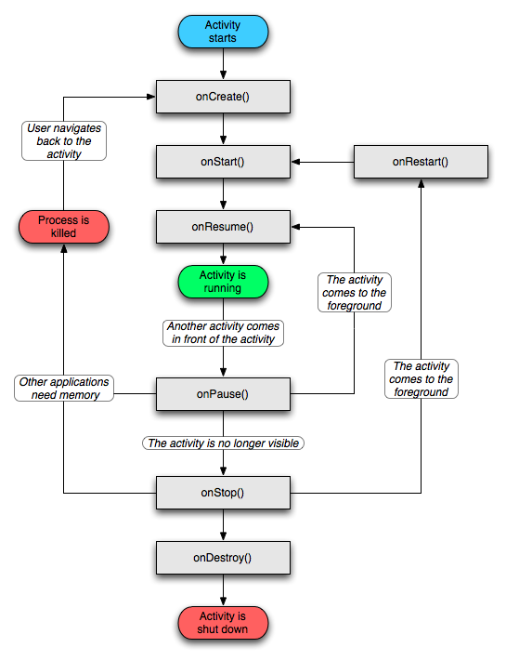

Slide 6
What is Layouts
Linear layout
Relative Layouts
Many more to explore in the next classes

Slide 7
TextView
<TextView android:id="@+id/lblSID"
android:layout_width="wrap_content"
android:layout_height="50dp"
android:layout_below="@id/adview"
android:text="SID : "
android:layout_alignParentLeft="true"
android:layout_margin="10dp"
/>

Slide 8
Edit text
<EditText android:id="@+id/edit_message" android:layout_weight="1" android:layout_width="0dp" android:layout_height="wrap_content" android:hint="@string/edit_message" />
// TODO : have to explore the the input types .
android:inputType="textEmailAddress"

Slide 9
Button’s
Normal Button
Image Button
Left draw able / right draw able
<?xml version="1.0" encoding="utf-8"?><Button xmlns:android="http://schemas.android.com/apk/res/android" android:id="@+id/button_send" android:layout_width="wrap_content" android:layout_height="wrap_content"
android:text="@string/button_send" android:onClick="sendMessage" />
/** Called when the user touches the button */public void sendMessage(View view) { // Do something in response to button click}

Slide 10
Button click event
Button button = (Button) findViewById(R.id.button_send);
button.setOnClickListener(new View.OnClickListener() {
public void onClick(View v) {
// Do something in response to button click }});

Slide 11
CheckBoxes
<CheckBox android:id="@+id/checkbox_meat" android:layout_width="wrap_content" android:layout_height="wrap_content" android:text="@string/meat" android:onClick="onCheckboxClicked"/>
public void onCheckboxClicked(View view) {
// Is the view now checked?
boolean checked = ((CheckBox) view).isChecked();
// Check which checkbox was clicked
switch(view.getId()) {
case R.id.checkbox_meat:
if (checked) // Put some meat on the sandwich
else // Remove the meat
break;
case R.id.checkbox_cheese:
If (checked) // Cheese me
else // I'm lactose intolerant break;
// TODO: Veggie sandwich }}

Slide 12

Radio Buttons
<RadioGroup xmlns:android="http://schemas.android.com/apk/res/android" android:layout_width="fill_parent" android:layout_height="wrap_content" android:orientation="vertical"> <RadioButton android:id="@+id/radio_pirates" android:layout_width="wrap_content" android:layout_height="wrap_content" android:text="@string/pirates" android:onClick="onRadioButtonClicked"/> <RadioButton android:id="@+id/radio_ninjas" android:layout_width="wrap_content" android:layout_height="wrap_content" android:text="@string/ninjas" android:onClick="onRadioButtonClicked"/></RadioGroup>

Slide 13
Click event
public void onRadioButtonClicked(View view) { // Is the button now checked? boolean checked = ((RadioButton) view).isChecked(); // Check which radio button was clicked switch(view.getId()) { case R.id.radio_pirates: if (checked) // Pirates are the best break; case R.id.radio_ninjas: if (checked) // Ninjas rule break; }}

Slide 14

Toggle Button
<ToggleButton android:id="@+id/togglebutton" android:layout_width="wrap_content" android:layout_height="wrap_content" android:textOn="Vibrate on" android:textOff="Vibrate off" android:onClick="onToggleClicked"/>

Slide 15
Detect click event
public void onToggleClicked(View view) { // Is the toggle on?
boolean on = ((ToggleButton) view).isChecked();
if (on) { // Enable vibrate }
else { // Disable vibrate }
}

